Slide 1
Creating Your Own Web Pages
Programming in HTML
Notes:
Students need “boat.bmp” in same drive as html file

Slide 2
HTML – What is It?
Programming Language
Used to design/create web pages
Hyper Text Markup Language
Markup Language
Series of Markup tags
Tags Describe the Content of a Document
HTML documents
Plain Text (Text / Information)
HTML Tags (Formatting, Setup)

Slide 3
Why Code in HTML
WYSIWYG editors are available (example: Word) to quickly and easily create Web Pages
Disadvantages to Image-Based Editors
Compatibility Issues
Text may be positioned in the wrong place so search engines (Google) won’t see it
Font sizes may not appear correctly
May display differently in different browsers
Expansion of website can be limited based on program’s design interface
HTML was meant for Document Structure not Design
Image-based editors work on the design

Slide 4
Advantages to HTML
Relatively simple programming language
Can create dynamic and rich web pages
Easy to learn / many online tutorials available
Site can be optimized for Search Engine Rankings
Image ALT attribute
Accessibility Issue
Used by Search Engines – include Key Words here
Heading Tag – Key Words in <h1> or <h2>
Display Compatibility
Use of Browser Specific Tags
Pages Load Faster
Editors create a lot of excess code / larger file sizes
Wider Range of Design Options using CSS Styles Sheets (separates content from the design)
Most editors use old technique of Tables to layout a page

Slide 5
HTML Code Example
<!DOCTYPE html>
<html>
<head>
<title> Title of my WebPage </title>
</head>
<body>
<h1> My First Heading </h1>
<p> My First Paragraph </p>
</body>
</html>

Slide 6
DocType
Defines the Document Type and the Standards used
Helps the Browser to Display the Page Correctly
<!DOCTYPE html>
HTML version 5
Version | Year Released
HTML | 1991
HTML+ | 1993
HTML 2 | 1995
HTML 3.2 | 1997
HTML 4.01 | 1999
XHTML 1.0 | 2000
HTML 5 | 2012
XHTML 5 | 2013*

Slide 7
Sections
<html>
Describes the web page
Provides details on how to display the data
<head>
Container for all of the header elements
Title, meta data, scripts, location of style sheets
<title>
Contained within the head
Defines the title for display on title bar, favorites list, search engine results
<body>
Contains the visible page content

Slide 8
HTML Tags
Keywords surrounded by angle brackets < >
Example: <html>
Normally (but not always) come in Pairs
Beginning and Ending Tags
<start> content text </end>
<p> text </p>

Slide 9
Web Browsers
Software that reads and displays HTML code
Internet Explorer
Firefox
Google Chrome
Safari
Does not display the HTML tags
Interprets them
Displays the Content

Slide 10
Create a Folder
Right-Click on Desktop
New
Folder
Name it with your Name

Slide 11
Create 1st Web Page
Can write HTML in any word processor or specialized software programs
Notepad is Readily Available (and Free)
Start → All Programs → Accessories → Notepad

Slide 12
Type in Code
<!DOCTYPE html>
<html>
<head>
<title> Type in Your Name Here</title>
</head>
<body>
<h1> My First Heading – Your Name Here </h1>
<p> My First Paragraph – About Me </p>
</body>
</html>
<!-- Spacing is not important -->

Slide 13
Save HTML Document
File Menu
SAVE AS
2) Your Folder
1) Select Desktop
3) Select “All Files”

Slide 14
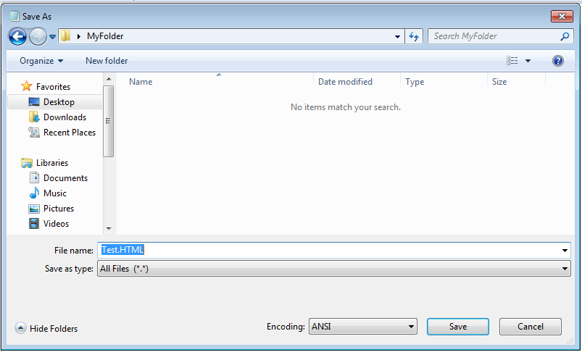
Save HTML Document
SAVE AS
YourName.HTML
3) YourName.HTML

Slide 15
Show in Web Browser
Open Your Folder on the Desktop
Double Click on Your Folder

Slide 16
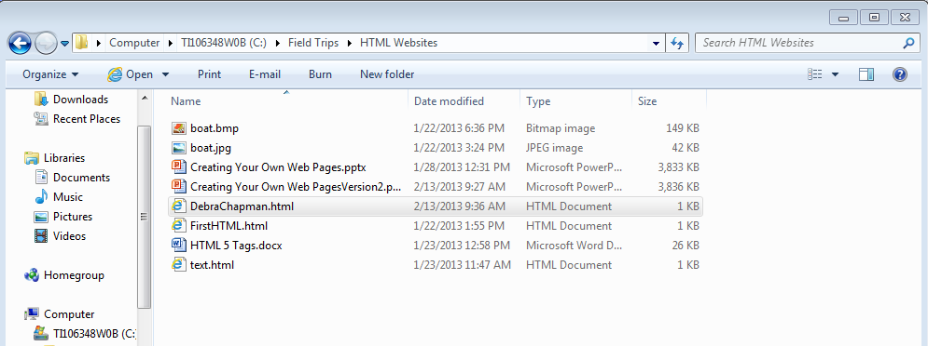
Show in Web Browser
Double-click on the File Name
Double-Click File Name

Slide 17
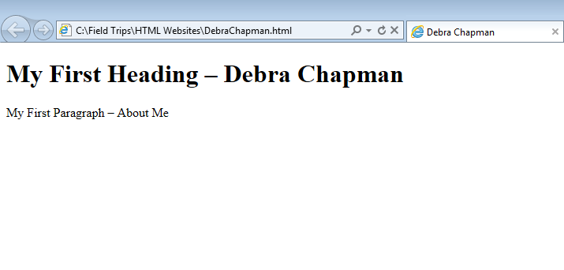
Show in Web Browser
Title
Heading
Paragraph
Only content included in <body> section displays in webpage

Slide 18
Headings
Headings are defined with <h1> to <h6> tags
H1 defines the most important (top level) heading
H6 is the least important (bottom level) heading
Headings are important for the structure of a web page
Do not use just to make text bigger
Key words in <h1> and <h2> for Search Engines

Slide 19
Headings
Add Headings to your HTML Document
In the <body> section
<body>
<h1> My First Heading – Your Name Here </h1>
<p> My First Paragraph – About Me </p>
<h2> School </h2>
<h3> Favorite Class </h3>
</body>
</html>

Slide 20
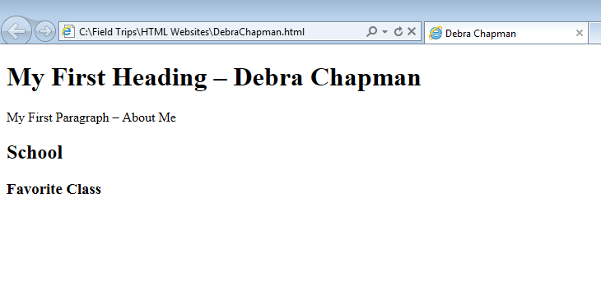
Headings
Save: File → Save
Note – Not “Save As”
Display in Web Browser to see Headings
H1
H2
H3

Slide 21
Paragraphs
HTML documents are divided into paragraphs
Empty lines are inserted before and after a paragraph
<p> My First Paragraph – About Me </p>
<p> My Family - Include 2-3 lines about your family here </p>
<p> My Best Friend - Include 2-3 lines about your best friend (human or pet) </p>
Add code to your Webpage
Save and Display

Slide 22
Paragraphs

Slide 23
Links
Hyperlinks allow you to click away from your page onto another page
Can be a word, a group of words, or a picture
Hyperlinks are one of the most important features of HTML documents
Links use the anchor tag <a>
Anchor Tags use a “href” attribute to indicate the link’s destination

Slide 24
Links
Syntax:
< a href=“url”> Link Text </a>
a → opens the anchor tag
href → gives the destination URL (address of the destination web page)
Link Text → Words that will display at the Link on the web page
/a → close anchor tag

Slide 25
Links
Example Link:
<a href = http://www.cis.usouthal.edu> School of Computing </a>
Add to your Web Page – before the </body>
Save and Display

Slide 26
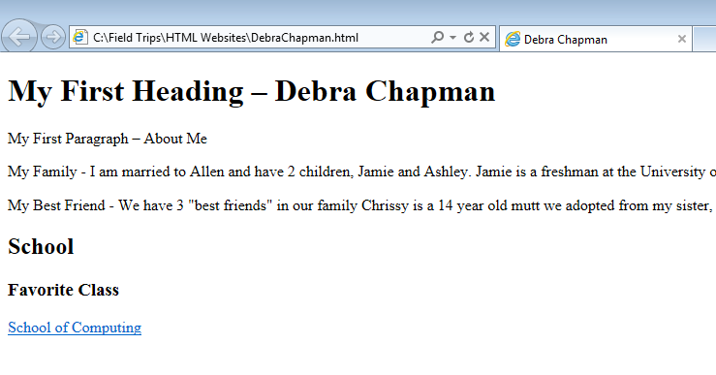
Links
Unvisited Links – blue and underlined
Visited Links – purple and underlined
Hyperlink

Slide 27
Images
Adding Pictures to your Web Page
Images use the img tag and a src attribute
Example:
<img src ="school.jpg" alt="My School">
src attribute – the location of the image file
alt attribute give alternate information about an image in case the viewer cannot see the image
Slow connection / Using a screen reader
Image Tags are “empty tags” – No Closing Tag

Slide 28
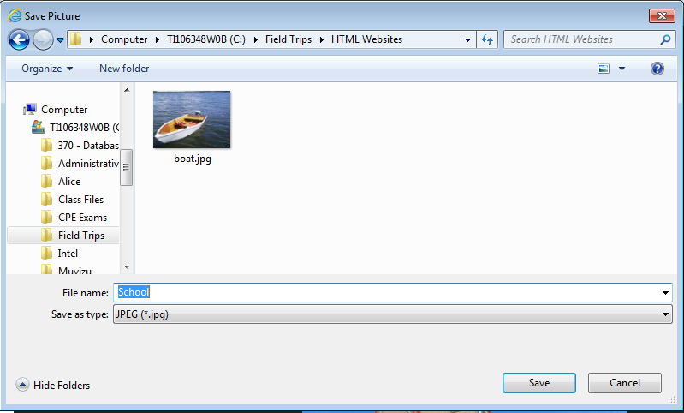
Download a Picture
Google → Images
Search – Your School
Right Click on a Picture
“Save Image As” → “School”
Same Folder
School
Notice File Type

Slide 29
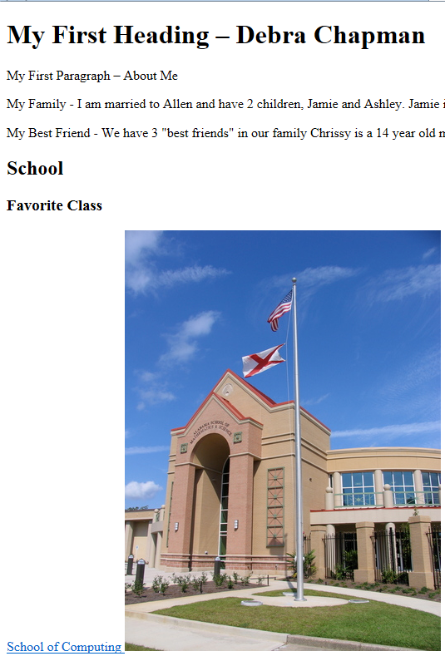
Images
Add code to Web Page:
<img src =“school.jpg" alt=“My School">
May be .jpg, .bmp or, .png
Save and Display

Slide 30
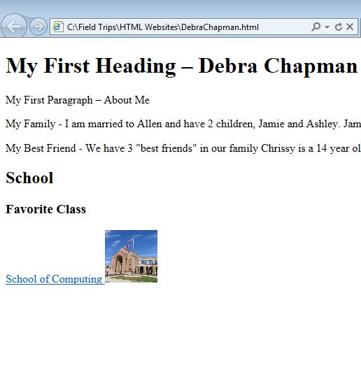
Images
To Size an Image include Width and Height properties
<img src =“school.jpg" alt=“My School"
width = 75 height = 75>
Used Pixels by default

Slide 31
Image Links
How would you include an Image as a Hyperlink
Link Code:
<a href = http://www.cis.usouthal.edu> Put Image Code Here Instead of Text</a>
Example:
<a href = http://www.cis.usouthal.edu> <img src =“school.jpg" alt=“My School“> </a>

Slide 32
Absolute and Relative Paths
Deals with links to documents and images
Absolute Paths:
Very specific location of file is included
Required when linking to files outside of your domain location
Example: <a href = http://www.cis.usouthal.edu> School of Computing </a>
Relative Paths:
Change depending on the page the links are on
Used within the same domain location
Links in the same directory as the current page have no path
<img src =“school.jpg" alt=“My School">
Sub-directories are listed without preceding slashes
<img src = “HTML_websites/school.jpg” alt=“My School”>

Slide 33
Lines
Lines can be used to separate content
Created with an <hr> tag
No need for an ending tag
Normally used with other tags
Add Code to Document
<hr> <p> My Family …</p>
Save and Display

Slide 34
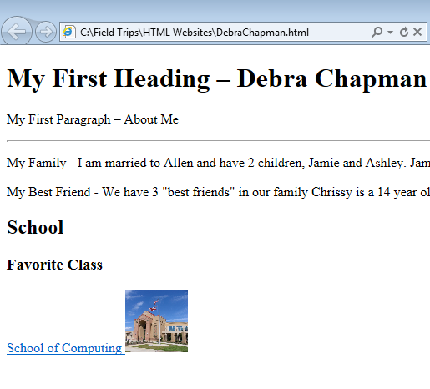
Lines
Line is Before Paragraph
You can put the <HR> tag after the end paragraph tag to move the line
</p> <HR>

Slide 35
Text Formatting
Formatting Tags:
<b> Bold
<em> Emphasized Text (not the same as italics)
<i> Italics
<small> Small Text
<strong> Strong (not the same as bold)
<sub> Subscript
<sup> Superscript

Slide 36
Text Formatting
Add some text and formatting to your webpage
Don’t forget end tags
Formatted text goes in between the tage
<b>Sample bold text </b><i>while this text it italic </i> <b> <i> This Text is Bold and Italic </b></i>
Save and View in Web Browser

Slide 37
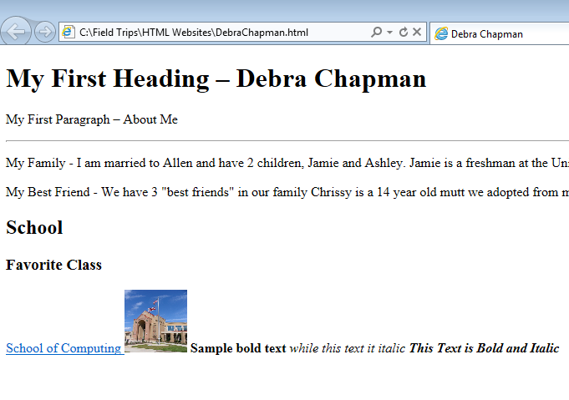
Text Formatting
Always test your code to make sure it is doing what you think it is doing
Should have bolding and italics

Slide 38
Comments
Comments are ignored by the Web Browser
Will not be displayed
Used to make your code more readable and understandable
Syntax:
<! - - This is My Comment - - >
Add a comment to your webpage

Slide 39
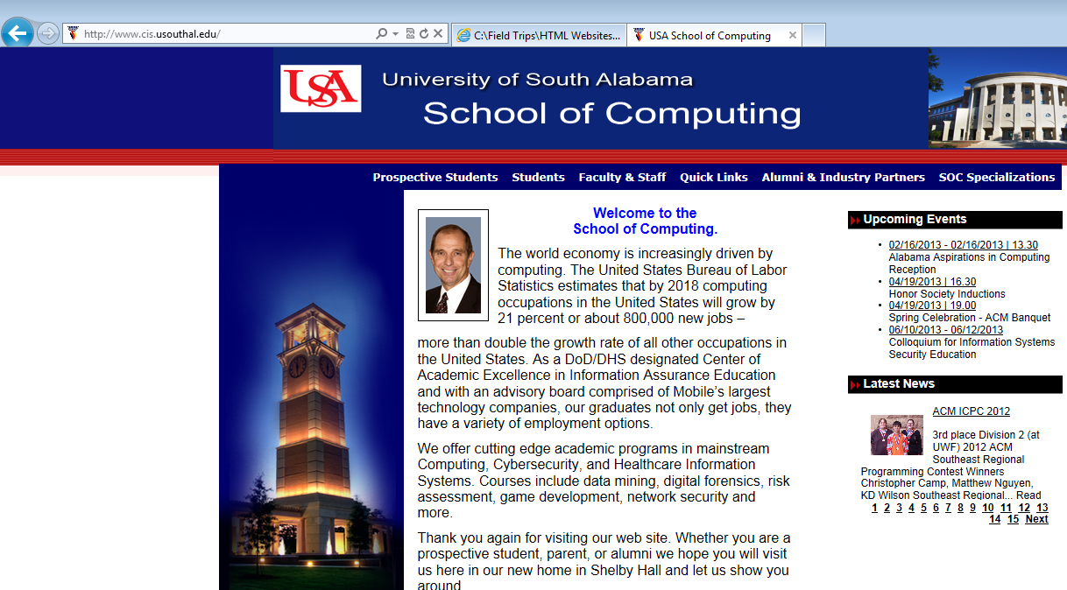
View HTML Code of Web Pages
Right Click in the Web Page
Select “View Source” or “View Page Source”

Slide 40
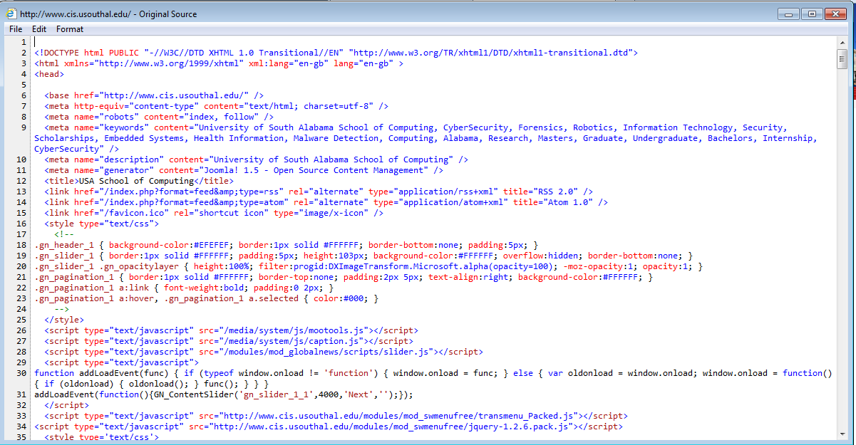
View HTML Code of Web Pages

Slide 41
W3C
World Wide Web Consortium
Standards Organization for XHTML
Create Standards and Protocols (Rules) for Web Development
Consistent Handling of Web Pages across browsers (and future browsers)
Accessibility Access
Users with Disabilities
Support future growth and development of the WWW

Slide 42
W3C Validation
Code Validator to Check Web Pages for Issues / Errors in Standards
Benefits:
Make sure pages are following the Standards
Documents Accessibility
Debugging Tools – Helps to find coding errors
Easier Maintenance of pages when standards are followed
Shows professionalism
http://validator.w3.org

Slide 43
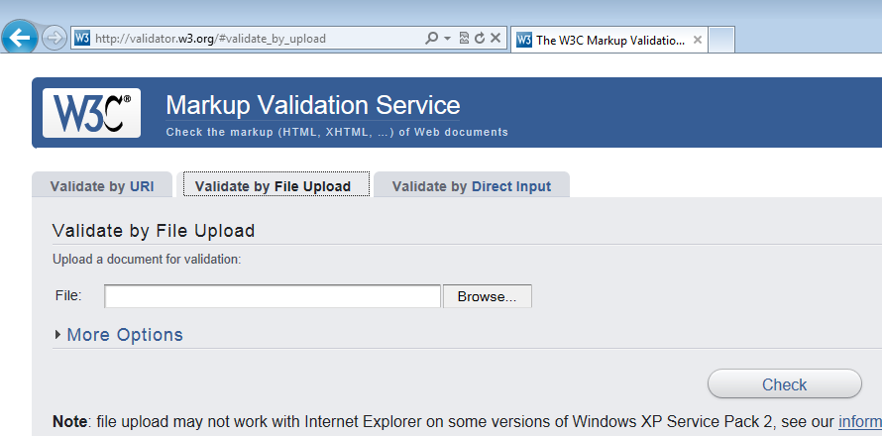
Validate Web Page
File Upload
Browse For File
Check

Slide 44
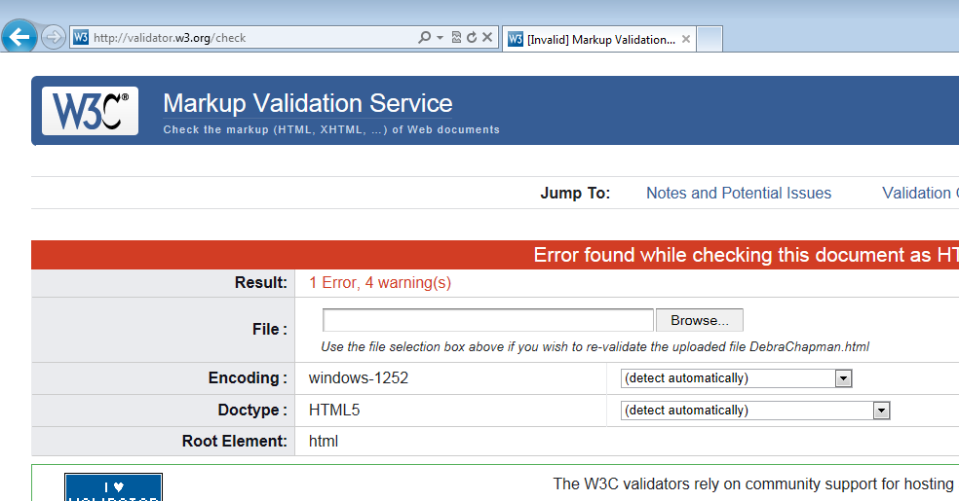
Validate Web Pages
Check your Results
Make Changes to Code if Needed

Slide 45
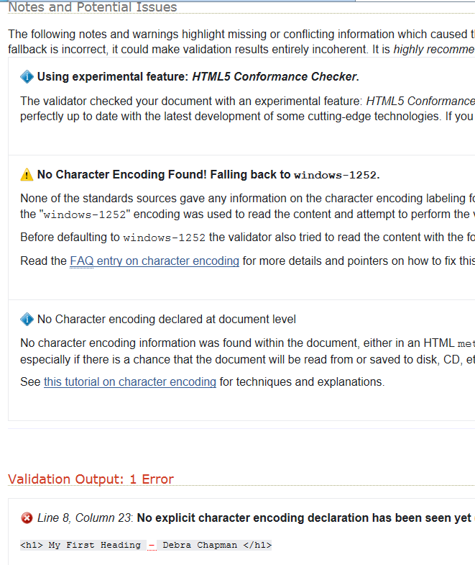

Slide 46
HTML in the Future
XHTML 5 is the new standard for 2013
It is a work in process
Not fully adopted yet
Most MAJOR browsers support many of the new elements
Some New Features
<canvas> element for 2D drawing
<video> and <audio> elements
New content elements
<header> / <footer> / <section>
Calendar and Date / Time controls

