Slide 1
Intermediate game making
Presented by the School of Computing and the Center for Forensics, Information Technology, and Security

Slide 2
introduction
We will now create a more involved game
In our game, we will consider more objects
We will also see the concept of Inheritance
We will create a game that has multiple rooms
Each time we clear a room, we will go to the next

Slide 3
Create a new game
Create a new game in Game Maker
Call it <Your Name>intermediate

Slide 4
The objects
A person
This object will define a person. It will be a player. We will define events on the person
Walls
These objects will represent the walls in a room
Doors
These objects will surround rings
Rings
These objects are used to allow to go to a different room
Diamonds
These objects represent things a player must gather before they can leave the room
Monsters
These objects represent obstacles to the player

Slide 5
The sprites
We will now create the sprites
We need sprites to represent
The player (person.png)
The walls (wall.png wall_horizontal.png wall_vertical.png wall_corner.png)
The diamonds (diamond.png)
The ring (ring.png)
The doors (door.gif door2.png)
The monster (monster1.png)
A goal (goal.png)
You will find images for each of these in the resources folder
Create sprites. Call them sprPerson, sprWall, sprWall_Horizontal, sprWall_Vertical, sprWall_Corner, sprDiamond, sprRing, sprDoor, sprDoor2, sprMonster, and sprGoal

Slide 6
Create the objects
Now create objects
Make sure that when you create the wall objects, you select Solid
Use the names objPerson, objDiamond, objMonster, objWall, objWall_Horizontal, objWall_Vertical, objWall_Corner, objRing, objDoor, and objDoor2

Slide 7
Inheritance
We would like for the person to interact with each wall in the same way
Instead of us creating events for each type of wall, we will end the wall objects so they all inherit from one object
Edit objWall_Horizontal, objWall_Vertical, and objWall_Corner and change the parent to objWall

Slide 8
Creating the rooms
We will create four rooms in this game. The first will simply be a starting screen
In the second room, we will create a maze that the player must move through to get to a ring. We will call the room rmMaze
Once they collect the ring, they are taken to the third room. We will call the third room rmDiamonds
In the third room, we will have a grid with diamonds scattered around. After the player collects all the diamonds, the doors around a ring disappear. Inside the doors is a ring. Once the player collects the ring, they are taken to the fourth room. We will call the fourth room rmMonster
In the fourth room, we will have goals scattered about, but monsters moving around
We will give the player three lives. If they collide with the monster, they lose a life. If they lose all of their lives before they collect the diamonds, they lose
Line the outer wall of each room with wall objects

Slide 9
Creating controller objects
We will create two objects that will be used to control the game
The first will be invisible. It’s events will be triggered after we click a key.
The second will be used to display the number of lives
We will call the first object start and the second object showlives
The start object will have two events: Create, Any Key (Note this is the Keyboard Event. It is not a Key Press event)
The showlives object will have a Draw event

Slide 10
The Events in start
THE EVENTS IN SHOWLIVES

Slide 11
Decorating the MAZE room
Place instances of the objWall_Horizontal, objWall_Vertical, and objWall_Corner around the room in the form of a maze and place a ring at a difficult to reach location
Place a person object in the lower right corner of the grid
Make sure to save your work

Slide 12
Adding events to the person object
We need certain things to happen
We want the person to start moving in a certain direction
If the person gets to the wall, they stop
If the person gets to the diamond, they go to the next room

Slide 13
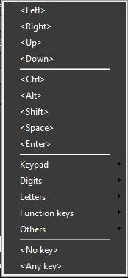
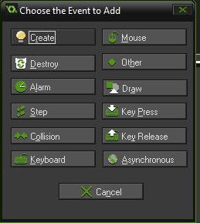
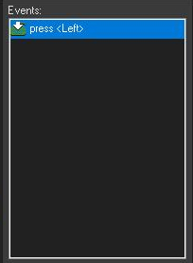
Creating keyboard events
Edit the person object and click on Add Event
Click on Key Press and you will see this menu
Let’s start with <Left> After you click on Left, you should see this

Slide 14
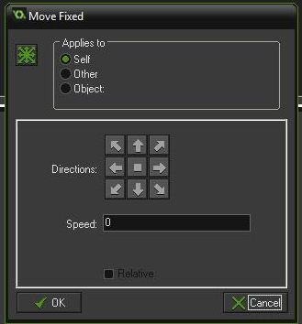
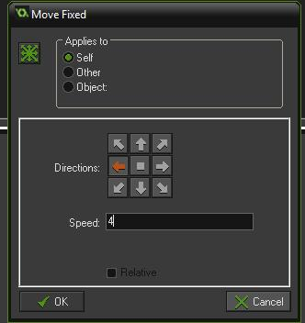
Defining what happens when the left arrow is clicked
To the right you will see a group of icons and a blank area. The blank area is a set of command that will happen when the event occurs
Drag the icon for Start Moving in a Direction into the blank area. This is the icon
Once you drag the icon into the blank area, you will
see this menu
Click the left arrow and change the speed to 4
Click OK

Slide 15
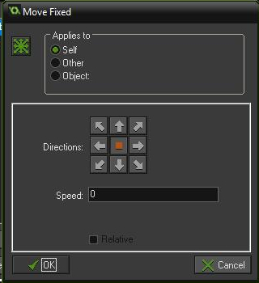
Test the event
Save your game
Now click Run
Your room should appear and notice what happens when you click the Left Arrow
The person goes through the wall
We need to define another event on the person so that they stop moving when they collide with a wall
On the person object click Add Event and choose Collision
In the blank area again drag the Start Moving in a Direction icon the blank area
This time choose the middle block

Slide 16
Add events for moving right, up, and down
Using the same procedure for moving left, add events for moving right, up, and down
Test the game again
Note that after you click an arrow the person starts moving. If you release the arrow, the person still keeps moving
To fix this, add another event where you test if the user is pressing no key. If they are then drag the Start Moving in a Direction icon to the blank area, but choose the middle square. This will make the person stop if we aren’t pressing a key

Slide 17
Advancing to the next room
In order to advance to the next room, we have to collect the ring
We will create a Collision event on the Ring object that will destroy the ring and go to the next room
You will find the Destroy Instance Icon in the main1 group on the right
You will also find the Next Room icon

Slide 18
The Diamonds Room
In the diamonds room, we are going to place diamonds at different locations
We are also going to place a ring in the room and surround it with doors
We are going to place events on the door object so that when all of the diamonds are collected, the doors will disappear
When we collect the ring we go to the next room

Slide 19
The monster room
In the monster room, we place several instances of the monster
We will have the monster move back and forth
If the player collides with a monster, they lose a life
We will place a ring in the room and surround it with doors
We will place an event on the door object so that if we have collected all the goals, the game restarts

